Slide 1


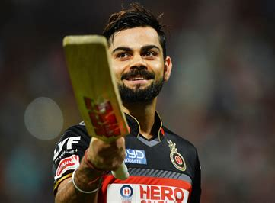
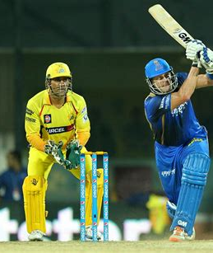

Predicting the Market Value of Individual Cricketers in the Indian Premier League
Springboard CAPSTONE PROJECT – Jonny Pearce – April 2023

Slide 2
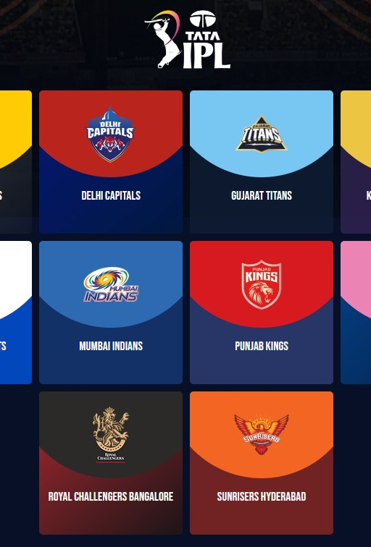
The PRoblem
Indian Premier League – one of the world’s biggest international sporting businesses
US$4.7bn market value in the 2021 season – TV/media, advertising, sponsorship, merchandising and betting markets all depend on success of teams and players
Operates on a franchise basis, with high profile international teams run by businesses, which bid/compete for the best players in an international auction
Buying the right players, having the right team purchasing strategy – crucial to business and sporting success
Overpaid upstarts or worth their weight in gold? What makes the most valuable IPL player and are they worth it?

Slide 3
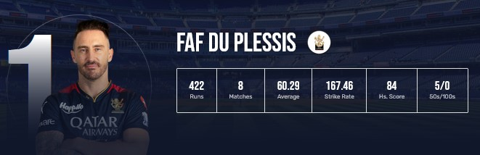
The data
Last two years of IPL auction data and player performance data
Scraped from IPL website
1000+ players in the auctions
250+ players’ performance data
started with 50 features, reduced to 28
Additional non-IPL performance data gathered, along with international cricketing salary information

Slide 4
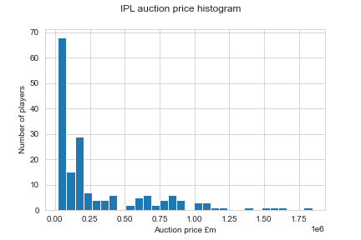
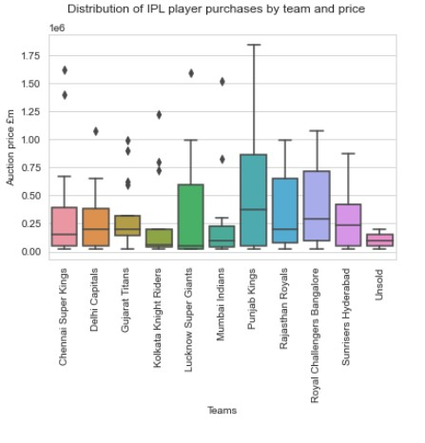
Exploratory analysis (1)
Right-skewed distribution for player purchases – very few players command high prices
Vast majority bought at low or mid-range (pile ‘em high, sell ‘em cheap)
Different strategies and success levels when looked at from a team perspective

Slide 5
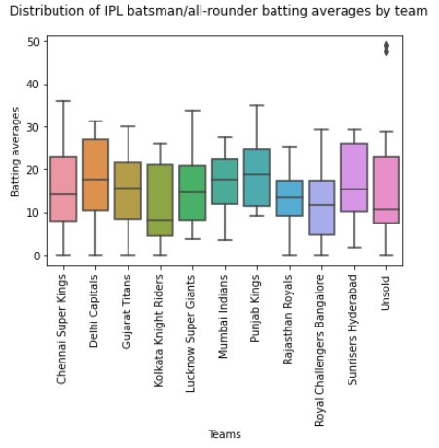
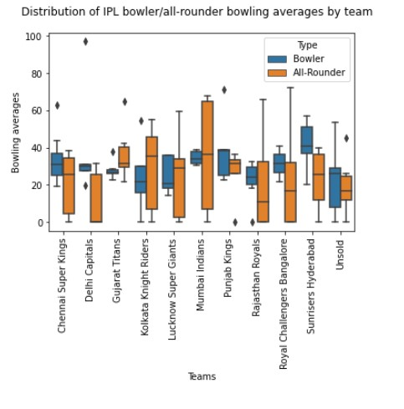
Exploratory analysis (2)
Remember – batting averages are better when they’re higher, bowling averages when they’re lower
Those spending the big money don’t always get the best results
Significant variation across teams
Non-specialists often outperform specialists

Slide 6
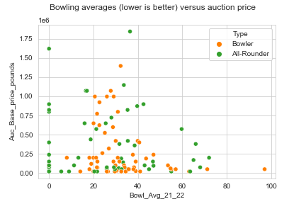
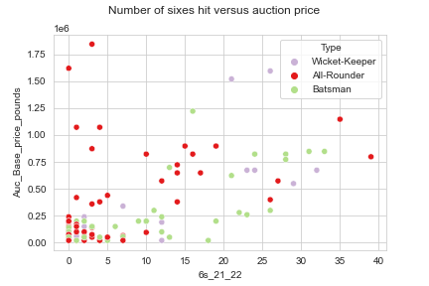
Exploratory analysis (3)
Scatter plots and heat maps produced
Hard to identify strong correlations, but interesting difference between types of players
Positive relationships between pricing and:
For batting: total runs, number of 50s, 6s scored
For bowlers: total wickets taken, bowling average, strike rate, dot balls bowled

Slide 7
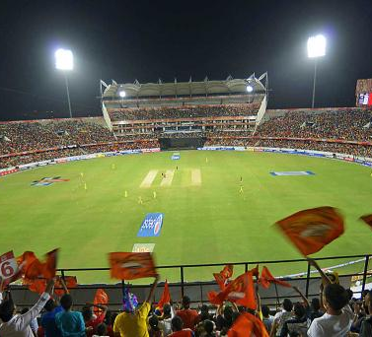
Pre-Processing
Feature data standardised:
Categorical data (eg, player type) – one-hot encoded
Continuous data (averages, strike rates, etc) – StandardScaler()
Discrete data (number of not-outs, 100s, 50s, 5-wicket hauls, etc) – MinMaxScaler()
Principal Component Analysis:
Of the 26 final features, first four or five PCA components accounted for the majority of the variance
Key features:
Bowling economy
Bowing strike rate
Batting average
Batting runs total
Bowling average

Slide 8
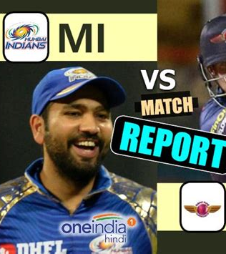
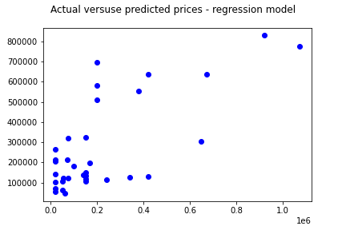
Model selection
Regression problem:
Linear Regression
Ridge Regression
Lasso Regression
RandomForestRegressor
All performed poorly – regression coefficient of 0.49

Slide 9
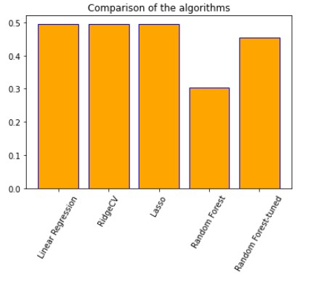
Results
Even with hyperparameter running including:
alpha and solver for Ridge Regression (involving the use of GridSearchCV),
the use of an adjusted alpha for Lasso Regression (found from cross-validation on the training data), and
a full parameter grid for the Random Forest Regressor (using GridSearchCV again).

Slide 10
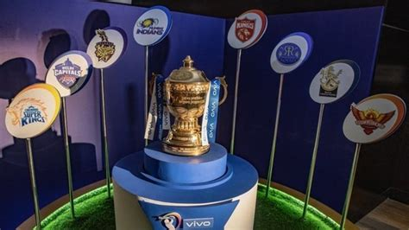
Conclusions and next steps
Number of possible reasons for poor model performance
Dataset is too small
Distortion within some of the data
Reality that players underperform or overperform in relation to their sale price
Limited engineering of the existing features
Highly priced players not playing, due to injury or unavailability
The player categories may be unhelpful
Lack of corresponding data on team success
Next steps:
Get/buy more data on previous years
Include data on team performance
Address data distortions and create additional features
Try again, with different models

Slide 11

Questions?

